Slide 1
Lecture 1b: Performance
To watch lecture video click link below
Lecture 1b video
To view slides, continue to next slide

Slide 2
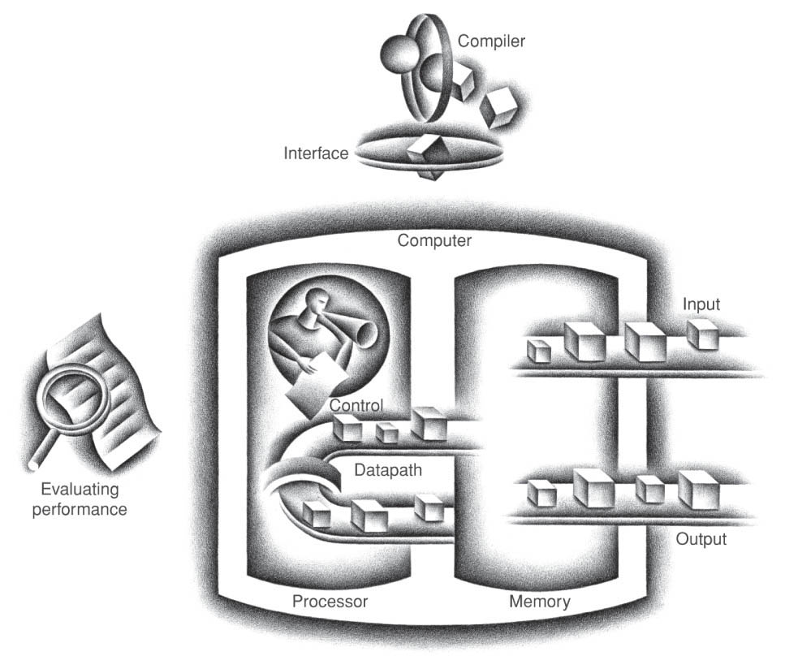
Lecture 1b: Performance

Slide 3
Definitions and Measurements
Figure credit: https://www.lansweeper.com/

Slide 4
Performance
Measure, Report, and Summarize
See through the marketing hype
always extravagant promotion on advertising?
Thinking Questions
Look at the computer you’re using now,
What kind CPU it uses?
What is the performance of this CPU?
Tell us where you found this information.
What does this CPU performance data really meant?
Make intelligent choices
Thinking Question
Assume you and your friend got the same amount of money, a Christmas gift for purchasing a computer, you’d purchase one mostly for video games while your friend want one mostly for developing computation intensive programs. Do you think you two would end up purchasing the same computer, why or why not?
In this course we focus on CPU performance, however, we use the terms CPU, machine, computer interchangeably.

Slide 5
Performance: From the Viewpoint of Computer Architecture
Key to understanding underlying organizational motivation
Why is some hardware better than others for different programs? What factors of system performance are hardware related? (e.g., Do we need a new machine, or a new operating system?) How does the machine's instruction set affect performance?

Slide 6
Definition of Performance
Figure credit: http://www.ramaircraft.com/

Slide 7
Which of these airplanes has the best performance?
Airplane Passengers Range (mi) Speed (mph)
Boeing 777 375 4630 610
Boeing 747 470 4150 610
BAC/Sud Concorde 132 4000 1350
Douglas DC-8-50 146 8720 544
Table 1.6.1 textbook
How much faster is the Concorde compared to the 747?
How much bigger is the 747 than the Douglas DC-8?
Which one has the best performance?
Throughput vs. Speed
see textbook table 1.6.1 for throughput calculation.

Slide 8
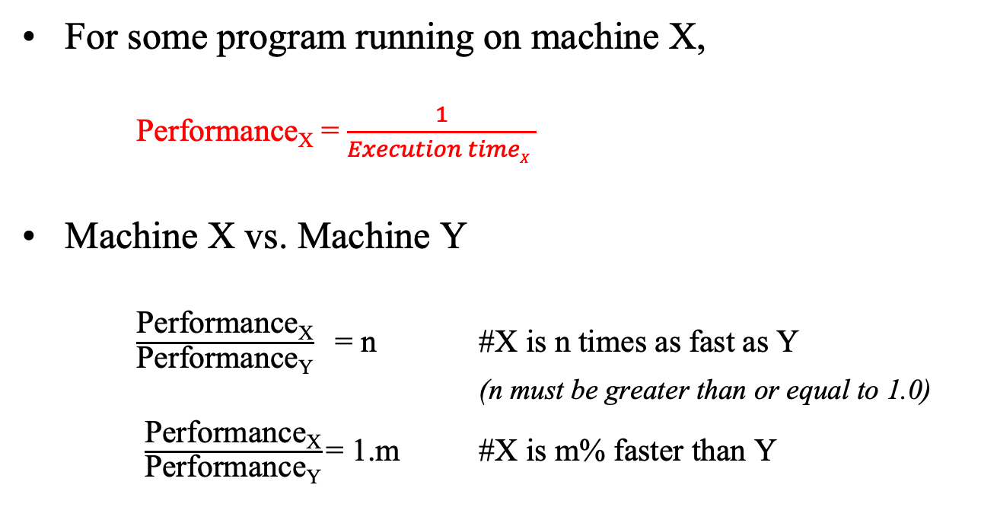
Book's Definition of Performance
For some program running on machine X,
Performance_{X} = $\frac{1}{Execution timeX }$
Machine X vs. Machine Y
$\frac{\text{Performance}\text{X}}{\text{Performance}\text{Y}}$ = n #X is n times as fast as Y (n must be greater than or equal to 1.0)
$\frac{\text{Performance}\text{X}}{\text{Performance}\text{Y}}$= 1.m #X is m% faster than Y

Slide 9
Practice Exercise
Assume:
machine A runs a program in 20 seconds
machine B runs the same program in 25 seconds
How much faster is A than B?
Pause: work on the problem

Slide 10
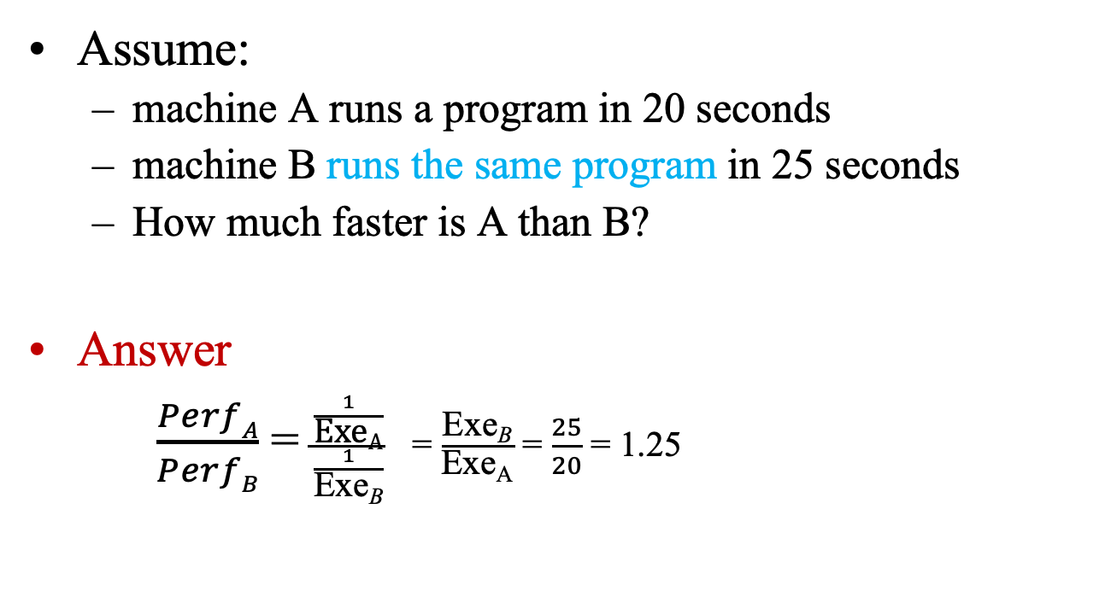
Practice
Assume:
machine A runs a program in 20 seconds
machine B runs the same program in 25 seconds
How much faster is A than B?
Answer
$\frac{PerfA}{PerfB}$ = $\frac{\frac{1}{\text{Exe}\text{A}}}{\frac{1}{\text{Exe}\text{B}}}$ = $\frac{\text{Exe}\text{B}}{\text{Exe}\text{A}}$ = $\frac{25}{20}$ = 1.25
Conclusion: A is 1.25 times as fast as B.
(or A is 25% faster than B.)

Slide 11
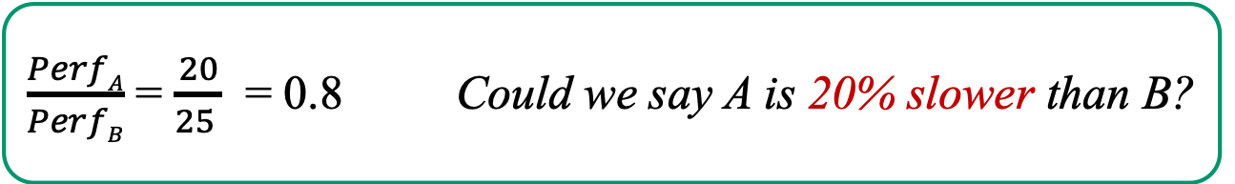
Practice Problem: Pitfall
Assume:
machine A runs a program in 25 seconds
machine B runs the same program in 20 seconds
How much faster is A than B?
$\frac{PerfA}{PerfB}$ = $\frac{20}{25 }$ = 0.8 Could we say A is 20% slower than B?

Slide 12
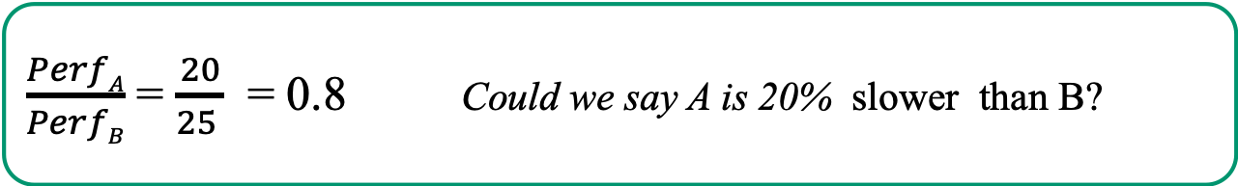
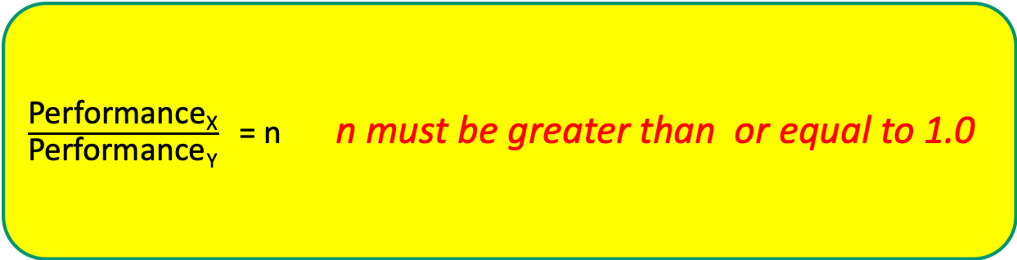
Practice Problem: Tips
Assume:
machine A runs a program in 25 seconds
machine B runs the same program in 20 seconds
How much faster is A than B?
$\frac{PerfA}{PerfB}$ = $\frac{20}{25 }$ = 0.8 Could we say A is 20% slower than B?
$\frac{\text{Performance}\text{X}}{\text{Performance}\text{Y}}$ = n n must be greater than or equal to 1.0
Recall the definition (Tips: follow the definition)

Slide 13
Execution Time
Elapsed Time
counts everything (disk and memory accesses, I/O , etc.)
a useful number, but often not good for comparison purposes
CPU time
doesn't count I/O or time spent running other programs
can be broken up into system time, and user time
Our focus: user CPU time
time spent executing the lines of code that are "in" our program
By default, when we say execution time or CPU time, we mean the user CPU time.

Slide 14
How to Calculate “User CPU Time”?
Time to execute all the instructions of a program
How many instructions in a program?
Differs by the compiler, i.e. compiler decides – CS4110
How much time to execute one instruction?
Need to calculate the cycles needed for each instruction or average cycles needed for one instruction.
Architecture/Organization design – CS3650!
How much time needed for one instruction?
CPU speed – organization/hardware design.
You know it when you bought the computer!

Slide 15
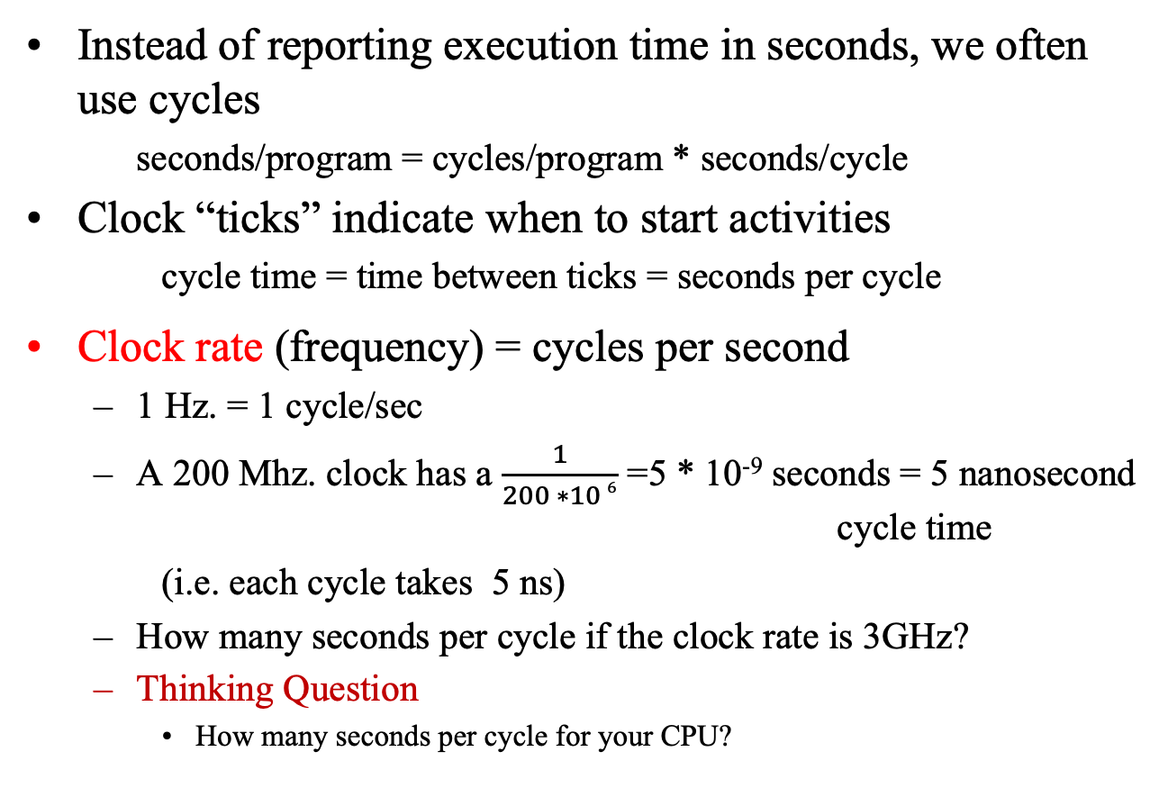
Clock Cycles
Instead of reporting execution time in seconds, we often use cycles
seconds/program = cycles/program * seconds/cycle
Clock “ticks” indicate when to start activities
cycle time = time between ticks = seconds per cycle
Clock rate (frequency) = cycles per second
1 Hz. = 1 cycle/sec
A 200 Mhz. clock has a $\frac{1}{200 ∗10 6}$ =5 * 10⁻⁹ seconds = 5 nanosecond cycle time
(i.e. each cycle takes 5 ns)
How many seconds per cycle if the clock rate is 3GHz?
Thinking Question
How many seconds per cycle for your CPU?

Slide 16
Hertz (Hz)
Submultiples |  |  | Multiples
Value | Symbol | Name | Value | Symbol | Name
10⁻¹ Hz | dHz | decihertz | 10¹ Hz | daHz | decahertz
10⁻² Hz | cHz | centihertz | 10² Hz | hHz | hectohertz
10⁻³ Hz | mHz | millihertz | 10³ Hz | kHz | kilohertz
10⁻⁶ Hz | μHz | microhertz | 10⁶ Hz | MHz | megahertz
10⁻⁹ Hz | nHz | nanohertz | 10⁹ Hz | GHz | gigahertz
10⁻¹² Hz | pHz | picohertz | 10¹² Hz | THz | terahertz
10⁻¹⁵ Hz | fHz | femtohertz | 10¹⁵ Hz | PHz | petahertz
10⁻¹⁸ Hz | aHz | attohertz | 10¹⁸ Hz | EHz | exahertz
10⁻²¹ Hz | zHz | zeptohertz | 10²¹ Hz | ZHz | zettahertz
10⁻²⁴ Hz | yHz | yoctohertz | 10²⁴ Hz | YHz | yottahertz
Source: http://en.wikipedia.org/wiki/Hertz (Common prefixed units are in bold face)

Slide 17
Second (s)
Submultiples |  |  | Multiples
Value | Symbol | Name | Value | Symbol | Name
10⁻¹ s | ds | decisecond | 10¹ s | Das | decasecond
10⁻² s | Cs | centisecond | 10² s | Hs | hectosecond
10⁻³ s | ms | millisecond | 10³ s | Ks | kilosecond
10⁻⁶ s | μs | microsecond | 10⁶ s | Ms | megasecond
10⁻⁹ s | ns | nanosecond | 10⁹ s | Gs | gigasecond
10⁻¹² s | ps | picosecond | 10¹² s | Ts | terasecond
10⁻¹⁵ s | fs | femtosecond | 10¹⁵s | Ps | petasecond
10⁻¹⁸ s | as | attosecond | 10¹⁸ s | Es | exasecond
10⁻²¹ s | zs | zeptosecond | 10²¹ s | Zs | zettasecond
10⁻²⁴ s | Ys | yoctosecond | 10²⁴ s | Ys | yottasecond
Source: http://en.wikipedia.org/wiki/Second (Common prefixed units are in bold face)

Slide 18
Clock Cycle Time: Calculation
A clock rate is 1GHz, how many cycles per second? What is the cycle time (i.e. time for one cycle)?
A clock rate is 4 GHz, how many cycles per second? What is the cycle time?
What is your computer’s CPU clock rate? How many cycles your CPU will issue per second? What is the time for 1 cycle?
Pause!
Calculate it.

Slide 19
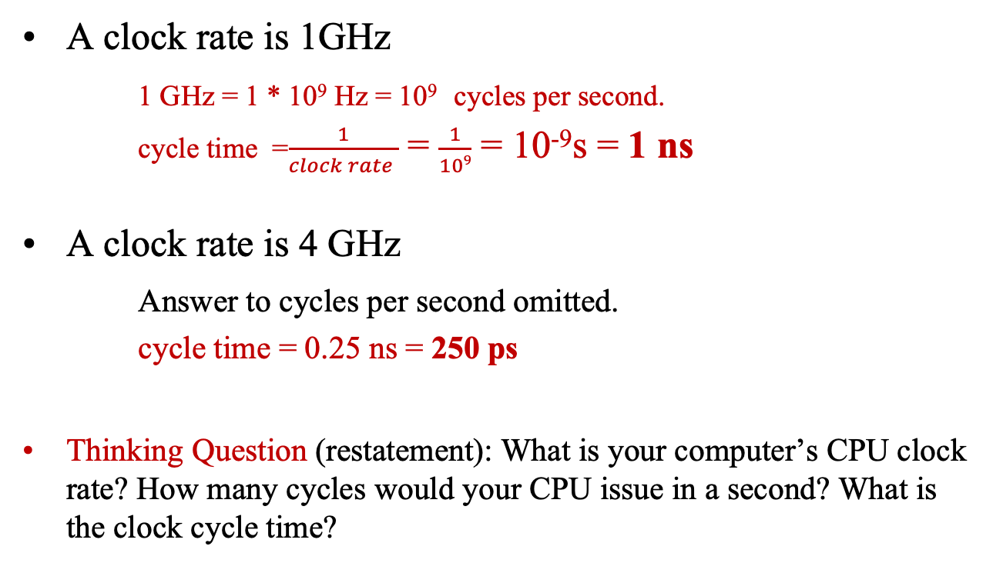
Clock Cycle Time: Calculation
A clock rate is 1GHz
1 GHz = 1 * 10⁹ Hz = 10⁹ cycles per second.
cycle time =$\frac{1}{clock rate }$ = $\frac{1}{109}$ = 10⁻⁹s = 1 ns
A clock rate is 4 GHz
Answer to cycles per second omitted.
cycle time = 0.25 ns = 250 ps
Thinking Question (restatement): What is your computer’s CPU clock rate? How many cycles would your CPU issue in a second? What is the clock cycle time?

Slide 20
How many cycles for a program?
Assumption
# of cycles = # of instructions?
This assumption is incorrect
different instructions take different amounts of time on different machines.
Why? Thinking Question
hints:
(1) remember that these are machine instructions, not lines of C/Java code;
(2) there are different types of instructions (CS2640)

Slide 21
Different numbers of cycles for different instructions
Multiplication takes more time than addition
Floating point operations take longer than integer ones
Accessing memory takes more time than accessing registers
Important point: changing the cycle time often changes the number of cycles required for various instructions (more later)

Slide 22
Cycle Per Instruction (CPI)
How many cycles needed to execute an instruction.
Generally speaking a machine may take 3 to 5 cycles to execute a simple instruction.
However, due to pipelining features (to be introduced in Module 4) an instruction might be completed in 1 to 2 cycles.
If a machine’s CPI is 3.5, doesn’t mean that it takes three and half cycles to execution an instruction. This refers to an average case.
For example, if 50% of the instructions need 4 cycles to complete while the other 50% of instructions take 3 cycles.
Thus, the (average) CPI is 3.5
For a specific machine, what is its CPI?
That’s determined by the Instruction Set Architecture (ISA) of the machine.
By default, we refer CPI as the average CPI of a machine.
And, from now on, we will use the terms CPI, ISA a lot.

Slide 23
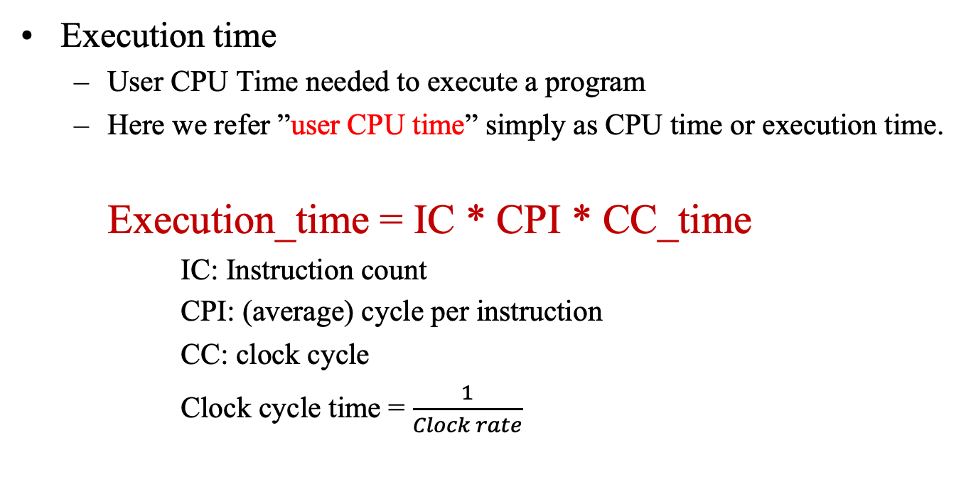
Execution Time: Calculation
Execution time
User CPU Time needed to execute a program
Here we refer ”user CPU time” simply as CPU time or execution time.
Execution_time = IC * CPI * CC_time
IC: Instruction count
CPI: (average) cycle per instruction
CC: clock cycle
Clock cycle time = $\frac{1}{Clock rate}$
Example, executing a program of 3 million instructions, with average CPI 4 on a machine with clock cycle time 500ps will take:
3 * 10⁶ * 4 * 500ps = 6 * 10⁹ ps = 6 ms

Slide 24
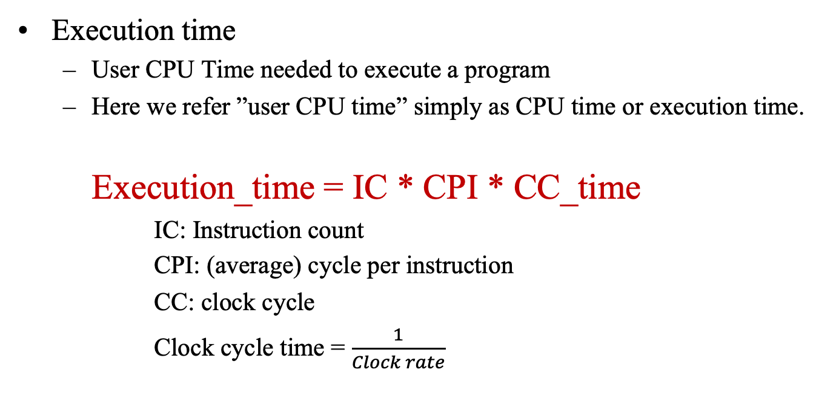
Execution Time: Calculation
Execution time
User CPU Time needed to execute a program
Here we refer ”user CPU time” simply as CPU time or execution time.
Execution_time = IC * CPI * CC_time
IC: Instruction count
CPI: (average) cycle per instruction
CC: clock cycle
Clock cycle time = $\frac{1}{Clock rate}$
Now, executing a program of 3 million instructions, with average CPI 4 on a machine with clock rate of 2 GHz, what will be the execution time?
#Thinking Question

Slide 25
Now let’s look at a comprehensive problem.

Slide 26
Problem
Our favorite program runs in 10 seconds on computer A, which has a 4 GHz clock.
We are trying to help a computer designer build a new machine B, that will run this program in 6 seconds.
The designer can use new (or perhaps more expensive) technology to substantially increase the clock rate, but has informed us that this increase will affect the rest of the CPU design, causing machine B to require 1.2 times as many clock cycles as machine A for the same program.
What clock rate should we tell the designer to target?
Give it a try!

Slide 27
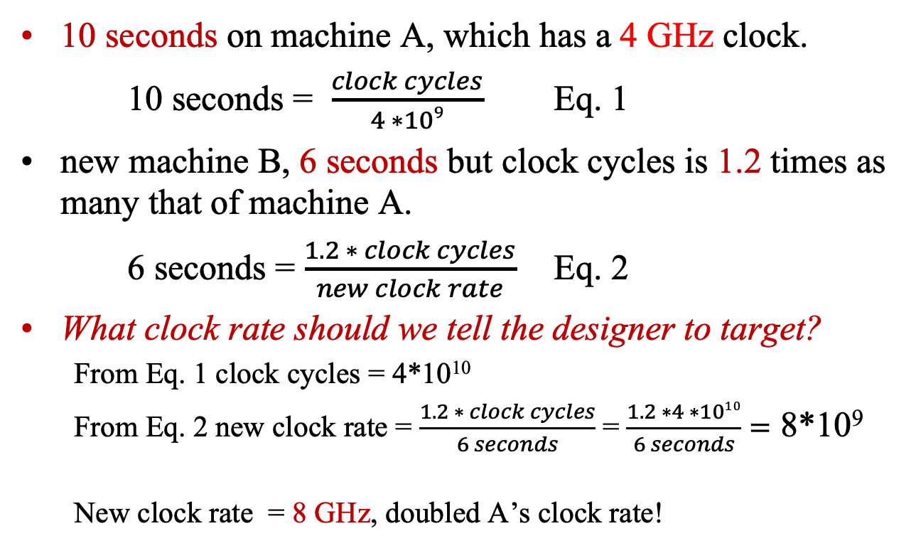
Solution
10 seconds on machine A, which has a 4 GHz clock.
10 seconds = $\frac{clock cycles}{4 ∗109}$ Eq. 1
new machine B, 6 seconds but clock cycles is 1.2 times as many that of machine A.
6 seconds = $\frac{1.2 ∗ clock cycles}{new clock rate}$ Eq. 2
What clock rate should we tell the designer to target?
From Eq. 1 clock cycles = 4*10¹⁰
From Eq. 2 new clock rate = $\frac{1.2 ∗ clock cycles}{6 seconds}$ = $\frac{1.2 ∗4 ∗1010}{6 seconds}=$ 8*10⁹
New clock rate = 8 GHz, doubled A’s clock rate!

Slide 28
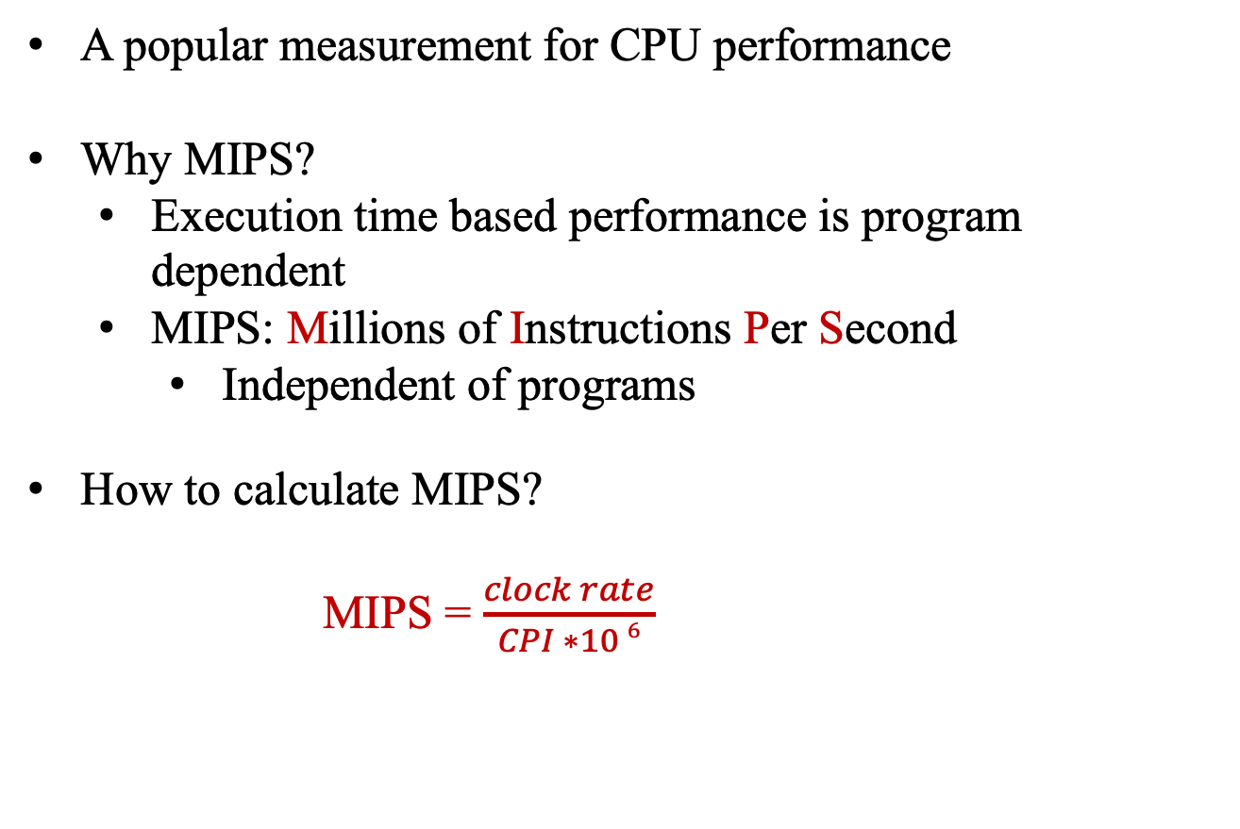
MIPS
What is MIPS? Oh, let’s me guess. Meaningless Indicator of Processor Speed?
A popular measurement for CPU performance
Why MIPS?
Execution time based performance is program dependent
MIPS: Millions of Instructions Per Second
Independent of programs
How to calculate MIPS?
MIPS = $\frac{clock rate}{CPI ∗10 6}$

Slide 29
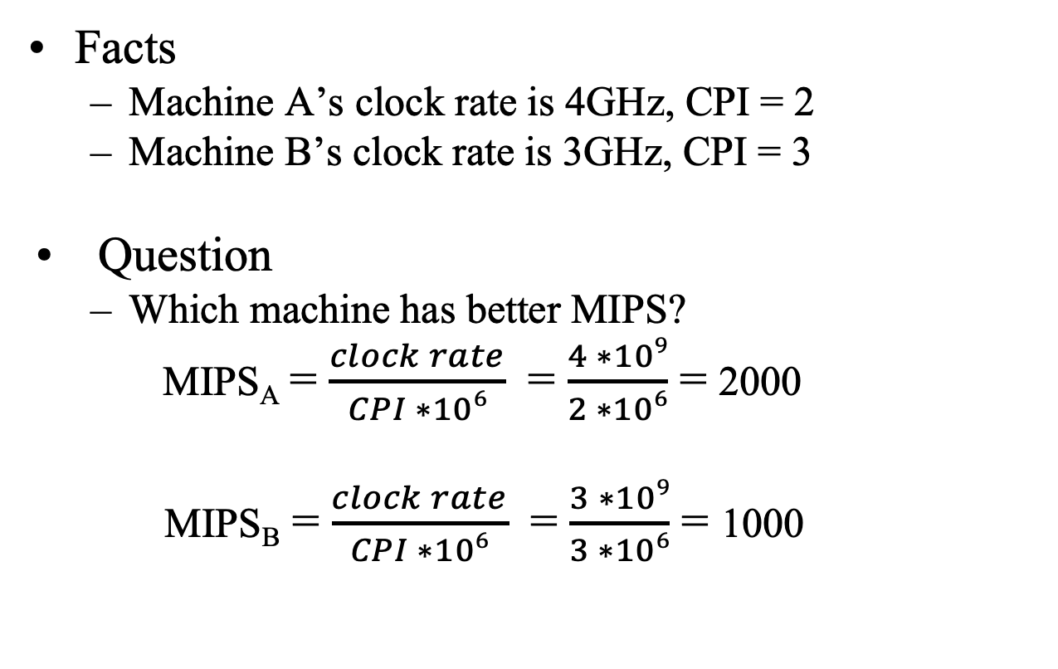
Example
Facts
Machine A’s clock rate is 4GHz, CPI = 2
Machine B’s clock rate is 3GHz, CPI = 3
Question
Which machine has better MIPS?
MIPS_{A} = $\frac{clock rate}{CPI ∗106}$ = $\frac{4 ∗109}{2 ∗106}$ = 2000
MIPS_{B} = $\frac{clock rate}{CPI ∗106}$ = $\frac{3 ∗109}{3 ∗106}$ = 1000
Pitfalls: MIPS can only be used to compare performance of two machines of same/similar ISA. If ISAs different, higher MIPS not necessary means better performance.

Slide 30
Thinking Questions
Q1: Look at the computer you’re using now, what kind CPU it uses? What is the performance of this CPU? Tell us where you found this information. (optional) What does this CPU performance data really meant?
Q2: Assume you and your friend got the same amount of money, a Christmas gift for purchasing a computer, you’d purchase one mostly for video games while your friend want one mostly for developing computation intensive programs. Do you think you two would end up purchasing the same computer, why or why not?
Q3: What is your computer’s CPU clock rate? How many cycles would your CPU issue in a second? What is the clock cycle time?
Q4: Why the number of instructions and the number of cycles may not equal?
Q5: Executing a program of 3 million instructions, with average CPI 4 on a machine with clock rate of 2 GHz, what will be the execution time?
Thinking questions: not assignment; team discussion encouraged; no need to submit; nor for credit.

Slide 31
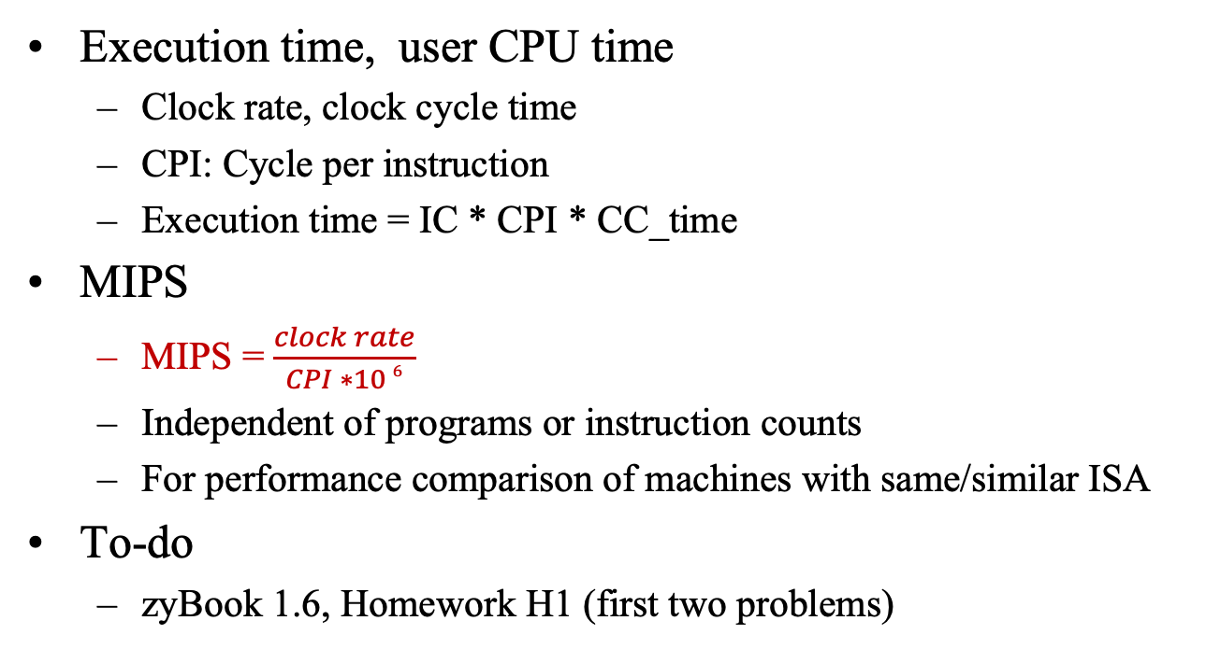
Summary and To-do
Execution time, user CPU time
Clock rate, clock cycle time
CPI: Cycle per instruction
Execution time = IC * CPI * CC_time
MIPS
MIPS = $\frac{clock rate}{CPI ∗10 6}$
Independent of programs or instruction counts
For performance comparison of machines with same/similar ISA
To-do
zyBook 1.6, Homework H1 (first two problems)

Slide 32
End of Lecture 1
Figure credit: https://www.amazon.com/Coffee-Break-Time-Relaxing-Music/
(not intended as promotion of any commercial product)

